Slide 1

Education 2020
Response to Future Challenges
Dr Daniel Tan
Chair, eLFA Board
e: ethtan@outlook.com
eLFA2018 Taipei - May 2018
Notes:
13:40-14:25
Plenary Session 1 : Dr. Daniel Tan
Chairman, eLearning Forum Asia
Topic: Education 2020: Response to Future Challenges

Slide 2

Change is not the only constant,
d²x
dt²
Rapiδ Change is

Slide 3
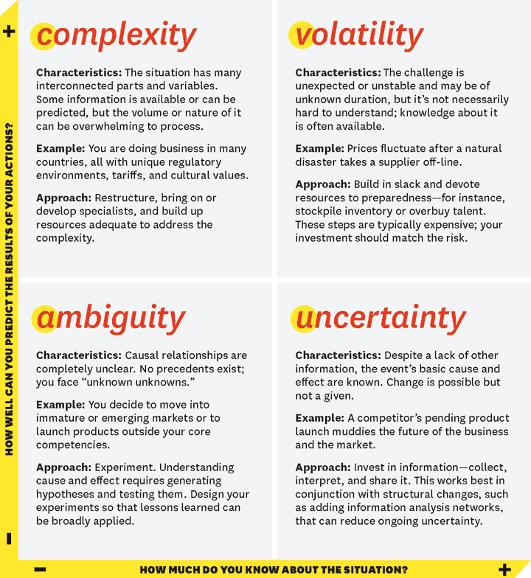
We live in a VUCA world of d1srup ti0n5
disrup
tions
Source: https://hbr.org/2014/01/what-vuca-really-means-for-you (2014)

Slide 4

Big
Picture

Slide 5
Big
Challenges

Slide 6

Challenge #1
A u t o mation

Slide 7
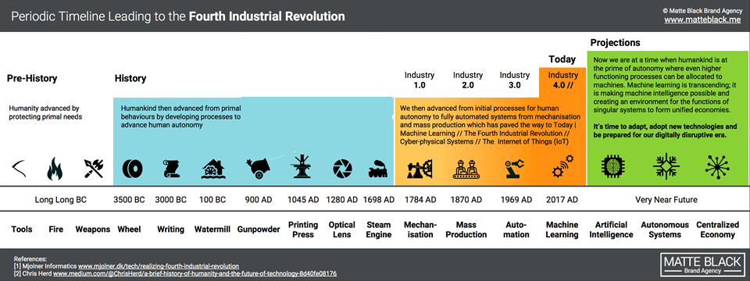
Industrial 4.0
Second Machine Age
Robotics • AI • Big Data • IoT • Mobile • Deep Learning
Source: https://matteblack.me/digital-disruption/

Slide 8
Technological Acceleration
50% adoption rates
Exponential Adoption
Linear Adoption
100
Television
Electricity
Telephone
Radio
Automobile
% Penetration
VCR
50
50%
PC
25
Cellular
Internet
0
25
50
75
100
125
150
Years
YEARS
Source: Christopher Bishop, IBM (2006)
Notes:
23-May-18 1:51 PM
8
From IBM Christopher Bishop
Newer technologies have been taking hold at two and three times previous rates
Years to reach 50% in marketplace adoption –
Radio – 38
TV – 13
Internet – 4
iPod 3
Facebook - 2
200 million users of My Space as of Sept 2006 –If it were a country it would be the 11th largest in the world – between Japan and Mexico
Number of text messages sent and received every day exceeds the number of people on the planet
40 exabytes (4.0 X 10 19th power) of new information will be generated this year-more than in the previous 5000 years
it’s a good time to be having this discussion about the changing nature of innovation.
Because as this chart illustrates, there’s simply no doubt that the pace of innovation, and the time between important new innovations, is changing.
Today, new technologies are taking hold at double or triple the previous rate.
Compare the penetration of cell phones in our society with the telephone.
The invention of the telephone took nearly 40 years to reach the same societal penetration as cellular technology has in five years.
All of which comes with implications for about ability to absorb, adapt and respond to the policy and ethical implications that always accompany technical advances.

Slide 9
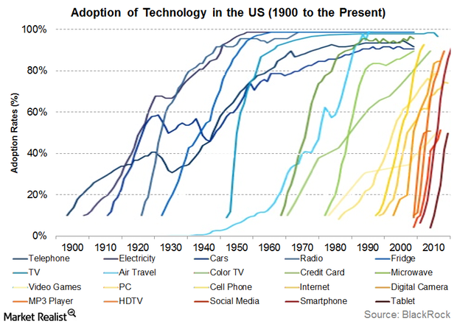
https://finance.yahoo.com/news/tech-adoption-rates-reached-dizzying-143221586.html (2015)

Slide 10
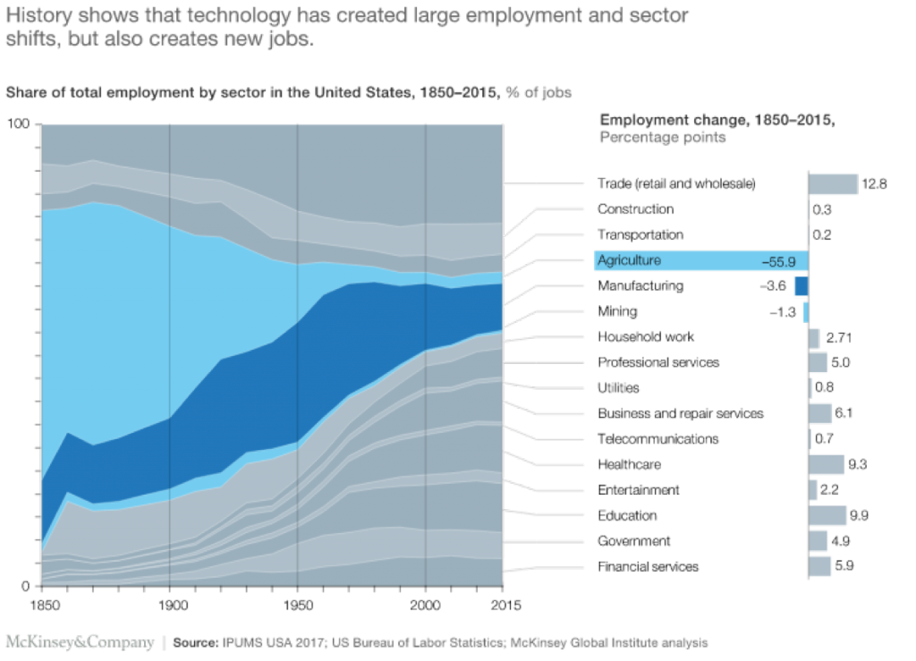
Technology Destroys Jobs, but Not Work
Notes:
Story of Madona

Slide 11
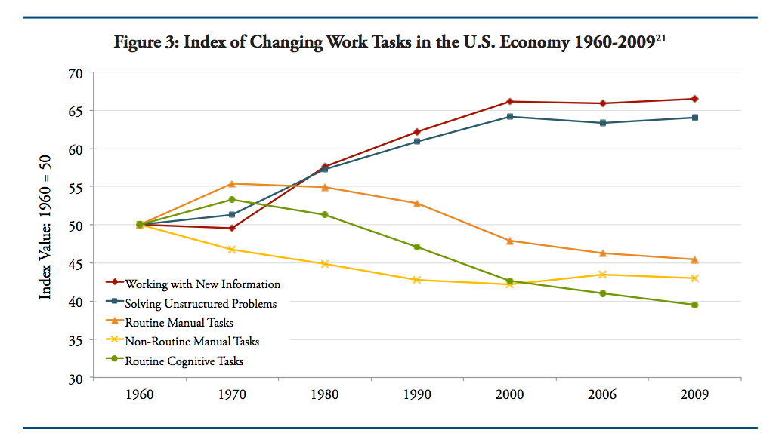
Structural Unemployment
• Old Jobs displaced by New Roles
• New jobs yet to be invented
Source: Dancing with Robots: Human Skills for Computerized Work
http://content.thirdway.org/publications/714/Dancing-With-Robots.pdf

Slide 12

Challenge #2
Empowered
Learners

Slide 13
Current &
Near
Future
Learning
Environments:

Slide 14
Current Mode
Content-based
Teacher-centric
Content
Textbook
Courseware
Learner
Receptor
Education 1.0 Learners
Receiving
Responding
Regurgitating
Teacher
Didactic
Communicator
Knowledge transfer
Source: https://usergeneratededucation.wordpress.com/tag/education-3-0/

Slide 15
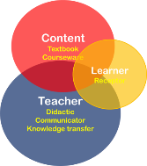
Emerging Model
Learning-based
Learner-centric
eContent
Internet
Web
OER
Video Lectures
Education 2.0 Learners
Communicating
Connecting
Collaborating
Content
Textbook
Courseware
Education 3.0 Learners
Connectors
Creators
Constructivists
Learner
Learner
Teacher
Facilitator
Curator
Reference: https://usergeneratededucation.wordpress.com/tag/education-3-0/

Slide 16
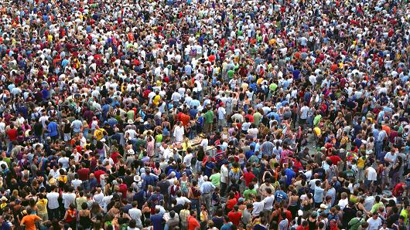
Psuedo-empowerment:
Population Profiles & Longevity
Source:
The University Challenge
By Mark McCrindle
https://www.slideshare.net/markmccrindle/the-university-of-the-future

Slide 17
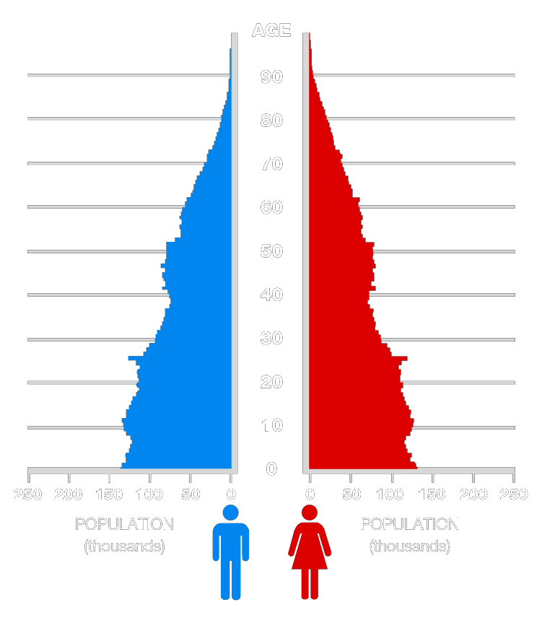
1973

Slide 18
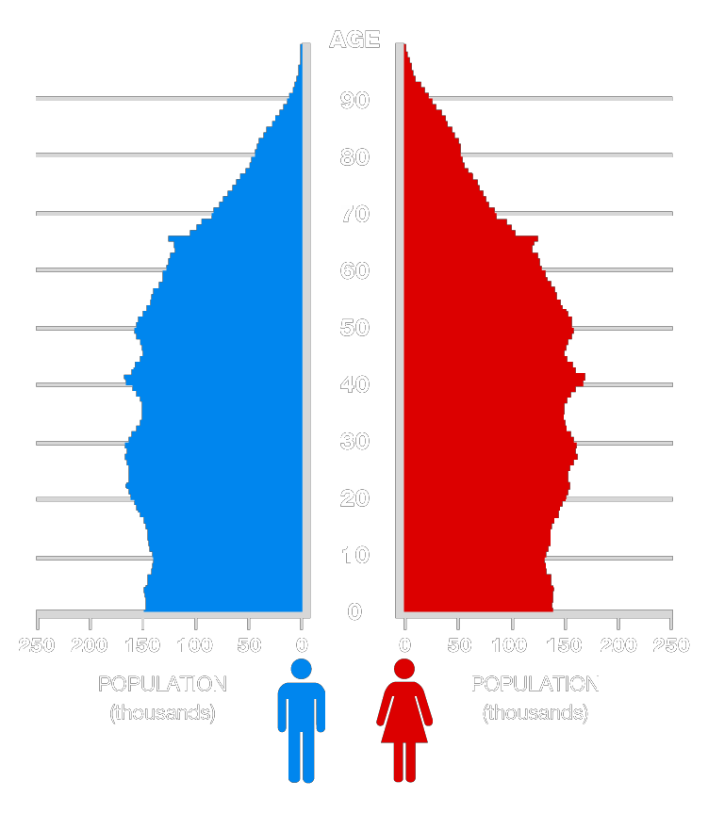
2013

Slide 19
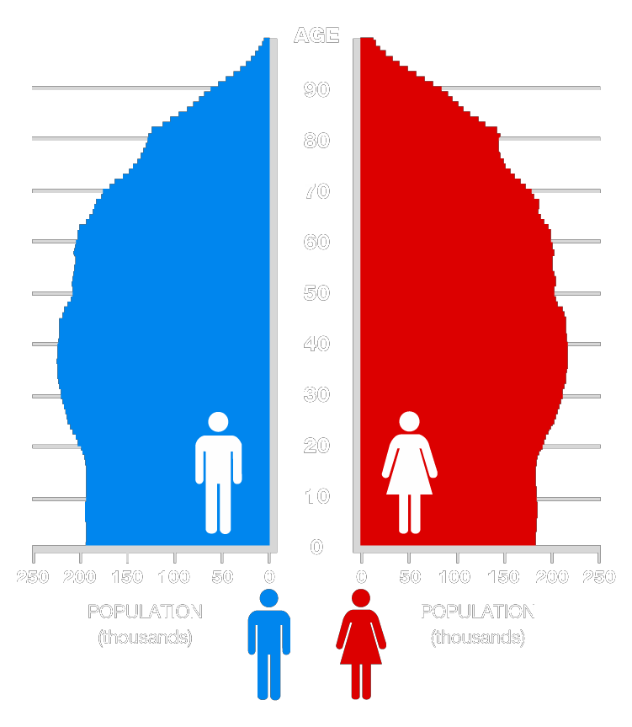
2053

Slide 20
Population: Today & 2050
Population Growth: 2011-2050 (in millions)
8.97
Over 65s
3.05
2050
2011
6.97
Under 18s
5.22
0
1
2
3
4
5
6
7
8
9
10
 | Under 18s | Over 65s
% increase | 34% | 294%

Slide 21
Population: Today & 2050
Population Growth: 2011-2050 (in millions)
Over 65s
2011
Under 18s
0
1
2
3
4
5
6
7
8
9
10

Slide 22
Population: Today & 2050
Population Growth: 2011-2050 (in millions)
More older people who are healthier and productive
Over 65s
2050
Under 18s
0
1
2
3
4
5
6
7
8
9
10

Slide 23
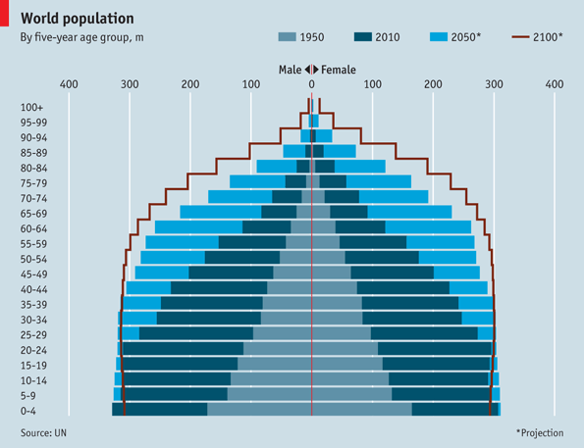
Life-long
Learners
coming
soon!
Source: https://www.economist.com/blogs/dailychart/2011/05/world_population

Slide 24

Early questions to ask
With people living longer and healthier, will retirement age be changed from the current 60 (or 65, etc)?
If not, then how will these retired people do with their time, energy and experience?
Is there a role and opportunity for educational institutions and organizations to “invent” new entities (businesses, roles, activities, etc)
What support will be required to enable productivity and job roles with these people?

Slide 25

Challenge #3
Evolving Competition
& Collaboration

Slide 26
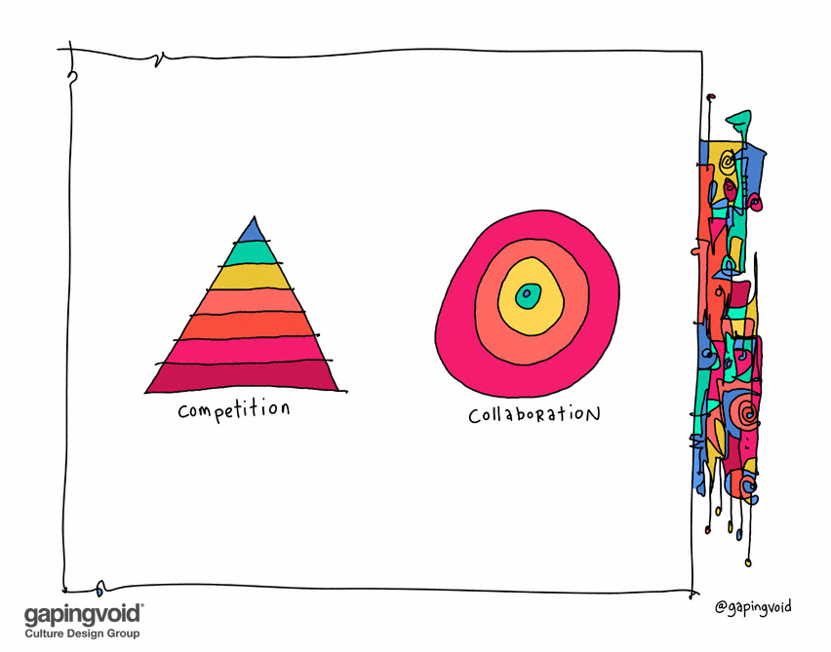
Source: https://www.gapingvoid.com/blog/2017/01/17/competition-collaboration/

Slide 27
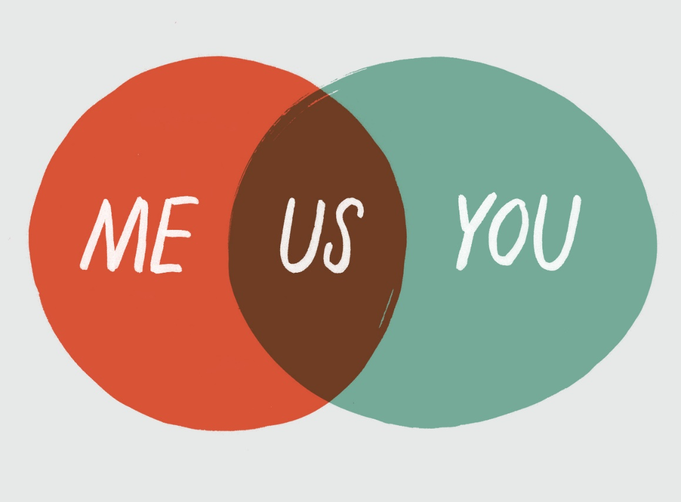
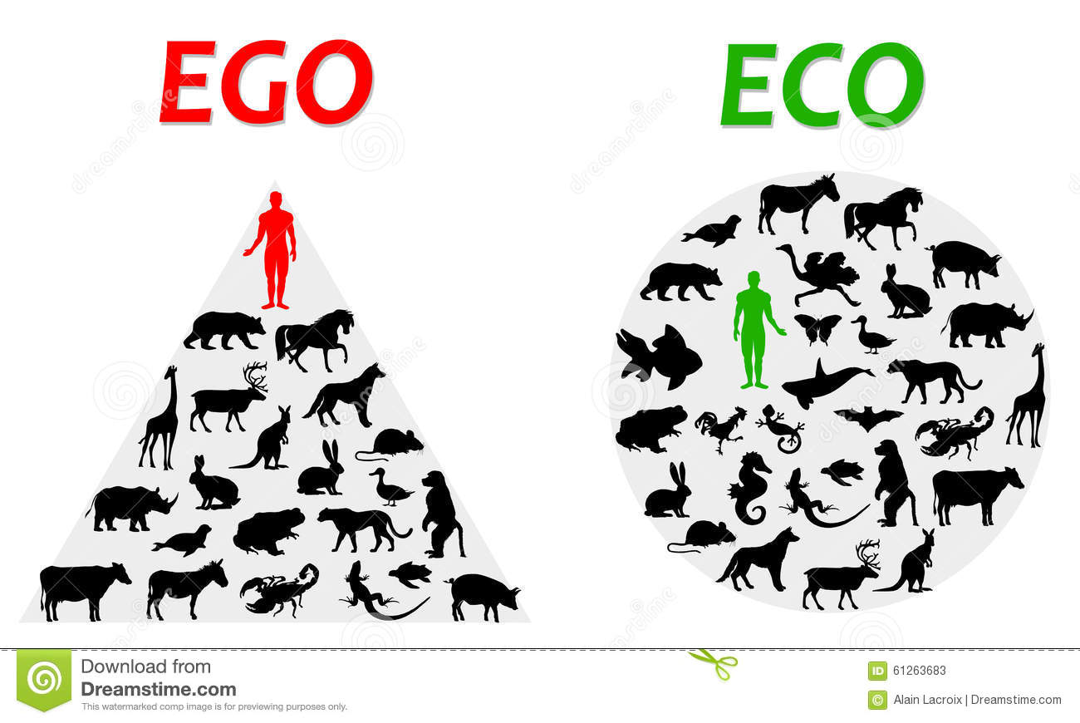

Slide 28
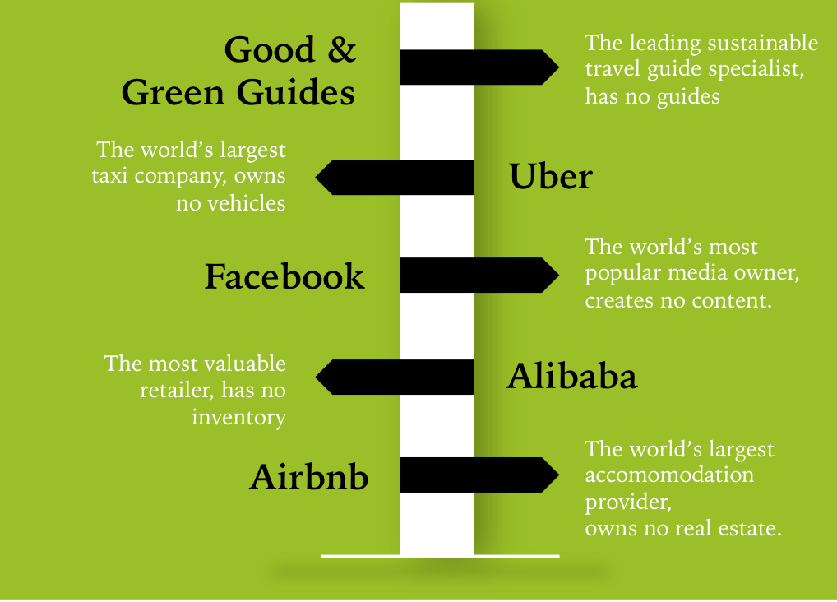
Internet as a platform
Notes:
Supermarket – many suppliers, one place
Supermarket vs supermarket
Internet as a platform
Wikipedia - free
bitcoin

Slide 29
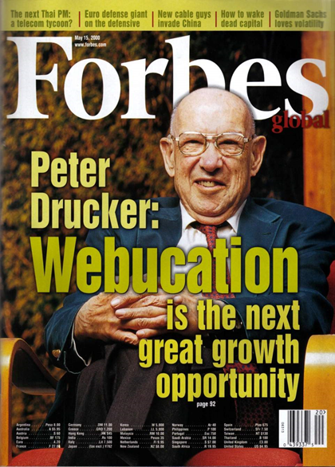
Peter Drucker: Forbes Magazine 15 May 2000
“If you have ever wished that you could just once be in the right place at the right time, you should seriously consider webucation itself, or marketing a webucation product. With the number of online users growing every day, the market is limitless and the opportunities are endless.
Online continuing education is creating a new and distinct educational realm, and it is the future of education. There is a global market here that is potentially worth hundreds of billions of dollars. "

Slide 30

Challenge #4
Emerging Generations
g

Slide 31
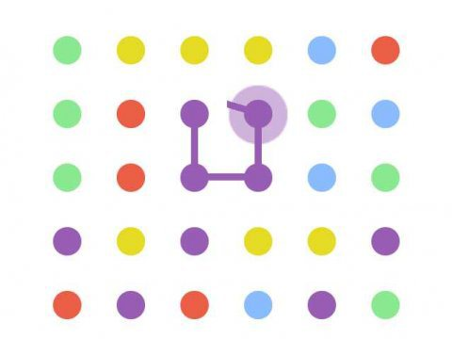



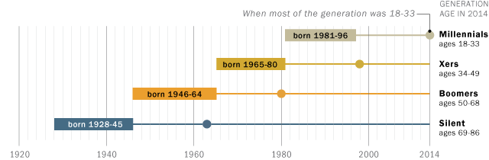
born 1997 - 2009
Age, as in 2014
Notes:
*** students are not the same

Slide 33

Putting all together

Slide 34
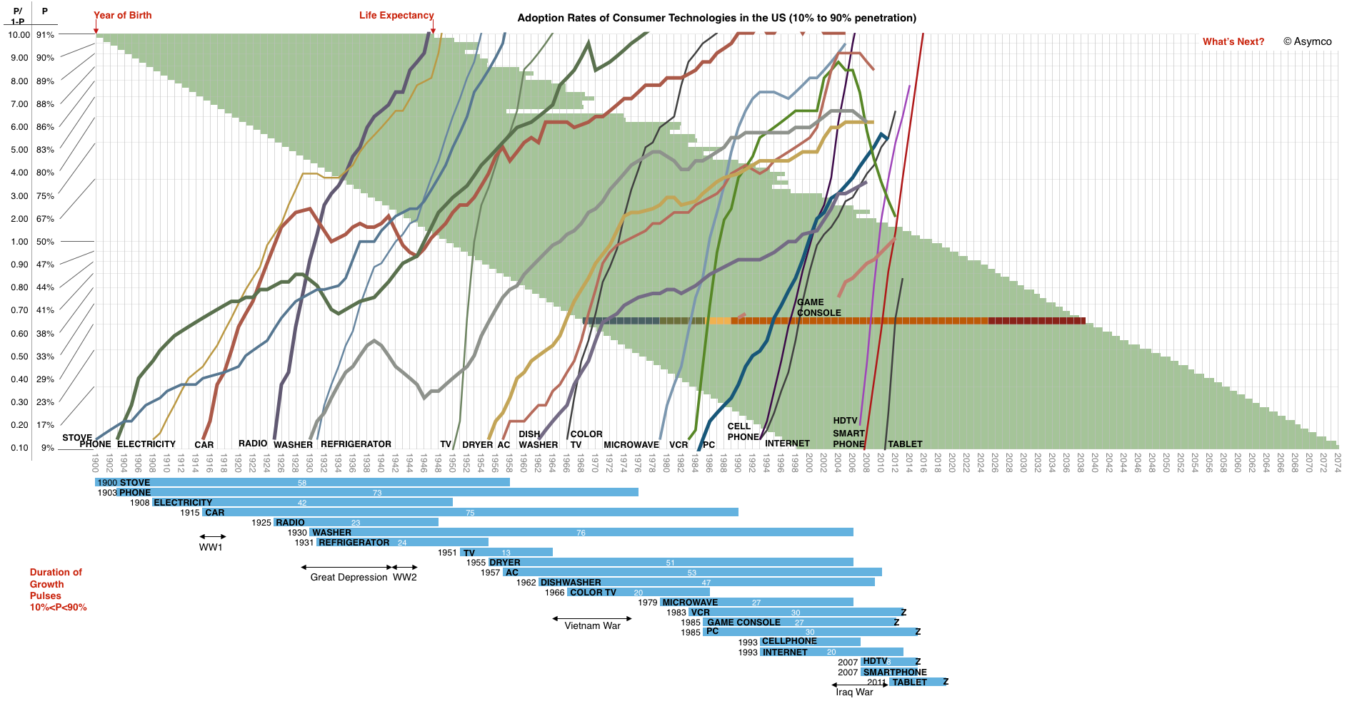
Technological Trends + Human Longevity
+ Generations
Pre-Internet/IR3 education
Internet/IR4 education
Baby Boomer
1946-1964
Gen X
1965-1980
Gen Y
1981-1996
Source: http://www.asymco.com/2013/11/18/seeing-whats-next-2/
Gen Z – 1997 - 2010
Notes:
Tech trends
Human longevity (on average)
- WW2
= see the people born in that particular exposed and experienced with the technologies
Example of bar – life/work cycle
Overlay – generations
Gen Z – 1997 - 2010
Implications: school and higher education was for an era
A few things to note:
The time scale has a yearly resolution spanning 1900 to 2074
The penetration scale is logarithmic and shows the ratio of Penetration/(1-Penetration) allowing a linear view of logistic growth.
The blue bars summarize the growth pulses and give a starting year and duration in years.
Note some traumatic events are marked on the time frame. They partly explain innovation gaps or decreases in adoption.
The life expectancy of Americans born from 1900 to 1998 is also shown as green bars. This allows the reader to trace which technologies emerged during the lifetimes of people they might have living memories of. I overlaid one specific lifetime beginning in 1968 and color coded with Childhood, Adolescence, Higher Education, Work live and Retirement as a guide. You can note how the PC emerged when that person would have been in college.
Some technologies have not yet saturated and may never do so. They are marked with a “Z” on the bar graph. It might be instructive to understand why.
You’ll also note that the time frame does not end today but that the technology curves do. The time frame includes the expected lifespan of someone born in 1998.
What will they see?
There is a lack of visibility or certainty among observers that anything worthy of inclusion on this graph will ever emerge.
And yet, when glancing at this graph, it would seem that the addressable market, the rate of introduction of new technologies and the speed of adoption have all increased. The area to the right of 2013 looks inviting to a plot of many lines.
Indeed, for the canvas to remain blank would be the riskiest of bets.

Slide 35
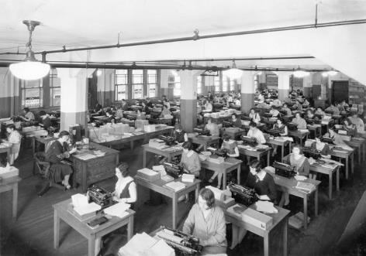

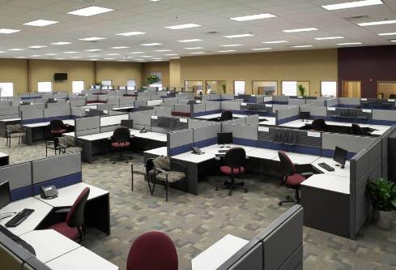
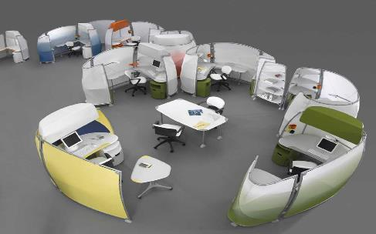
Classical Work Organizations

Slide 36
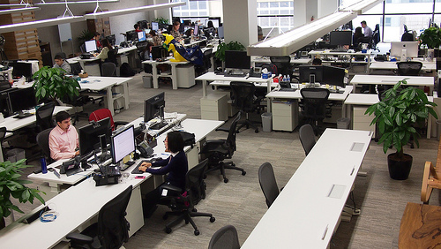
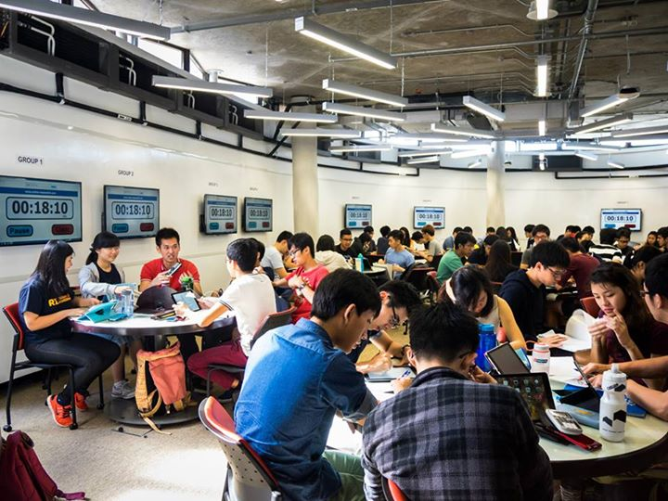
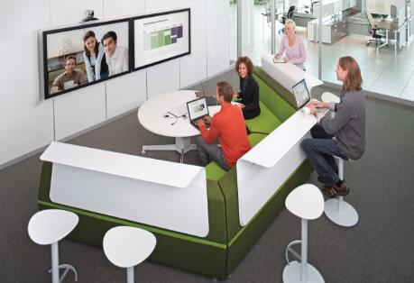
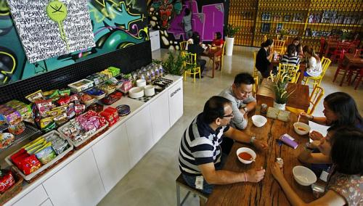
New Digital Organizations

Slide 37
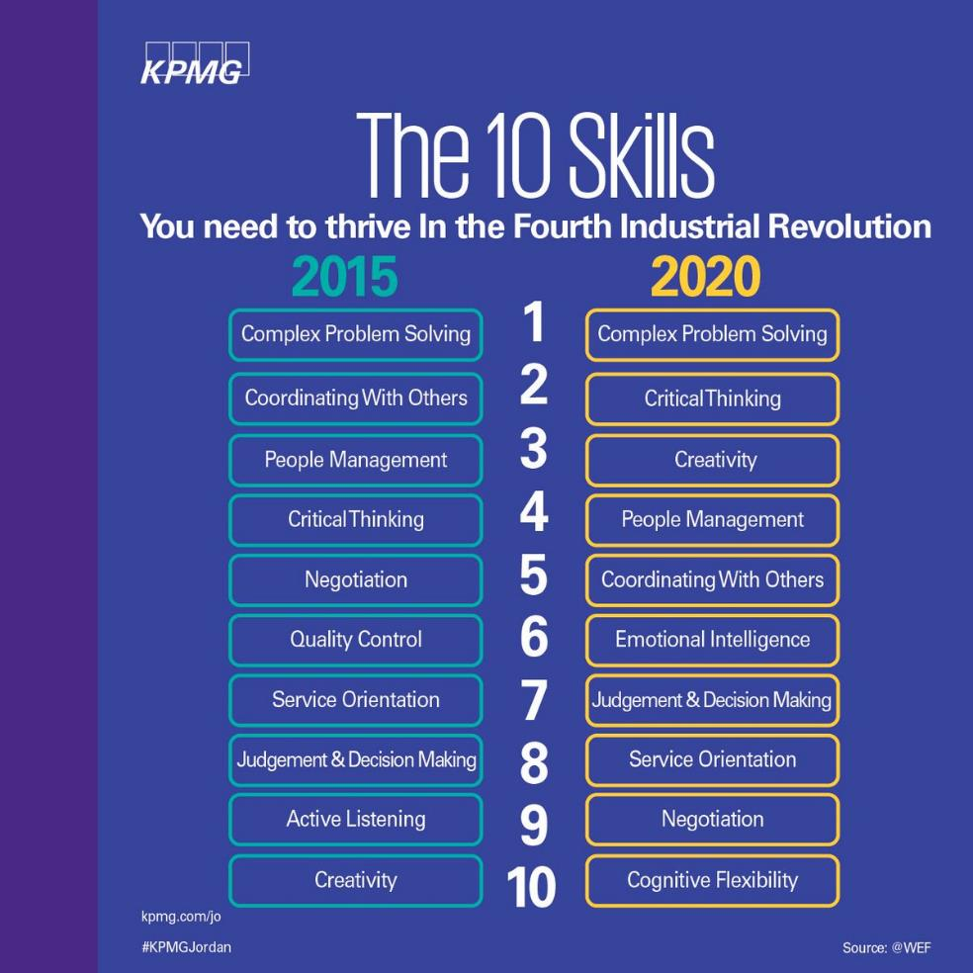
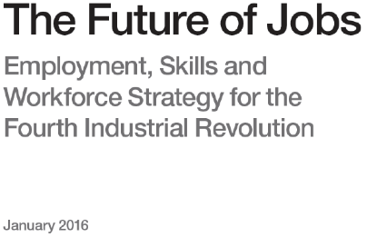
Today’s soft
skills are tomorrow’s hard skills

Slide 38









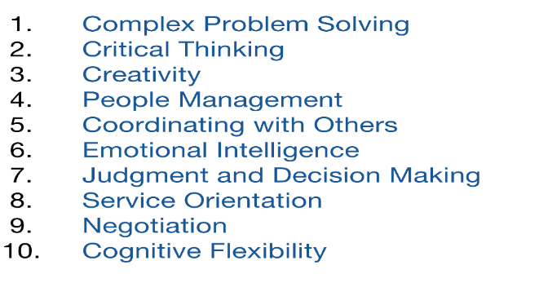


Challenge:
Workplace employers expects the new graduate employee to be “work ready”!

Slide 39
Response to Challenges

Slide 40


If the rate of change on the outside exceeds the rate of change on the inside,
the end is near.”
Jack Welch
An organization's ability to learn, and translate that learning into action rapidly, is the ultimate competitive advantage.

Slide 41
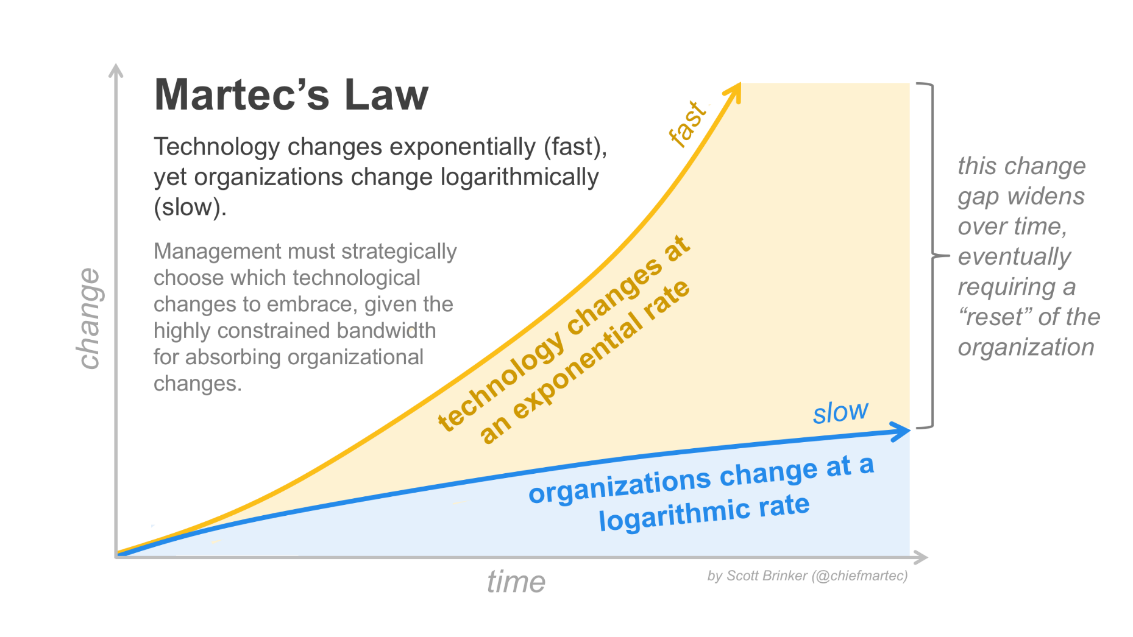
Work-place Shifts in an Information-Rich World
Source: https://chiefmartec.com/2013/06/martecs-law-technology-changes-exponentially-organizations-change-logarithmically/

Slide 42
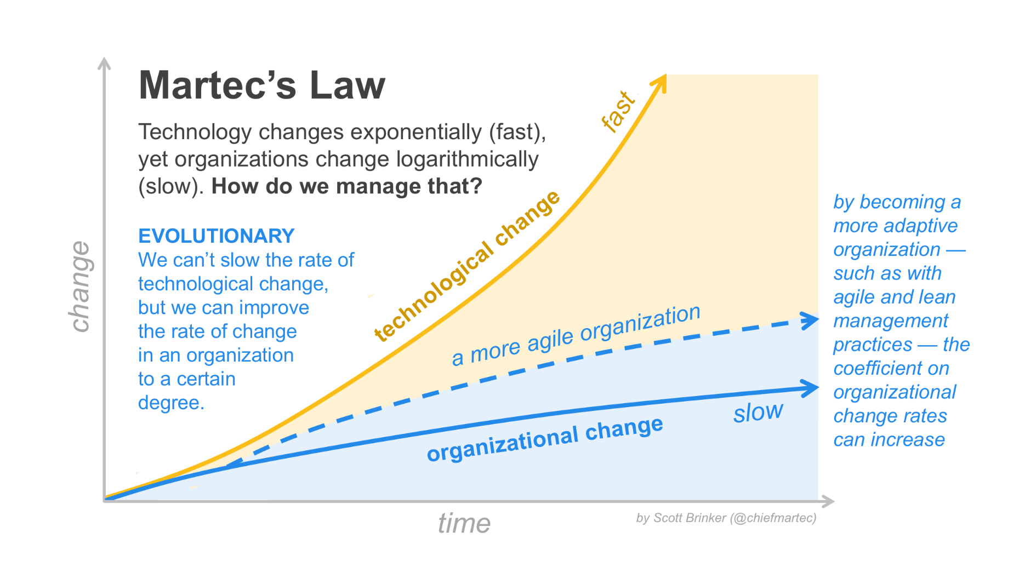
Good Way to Response: Evolve

Slide 43
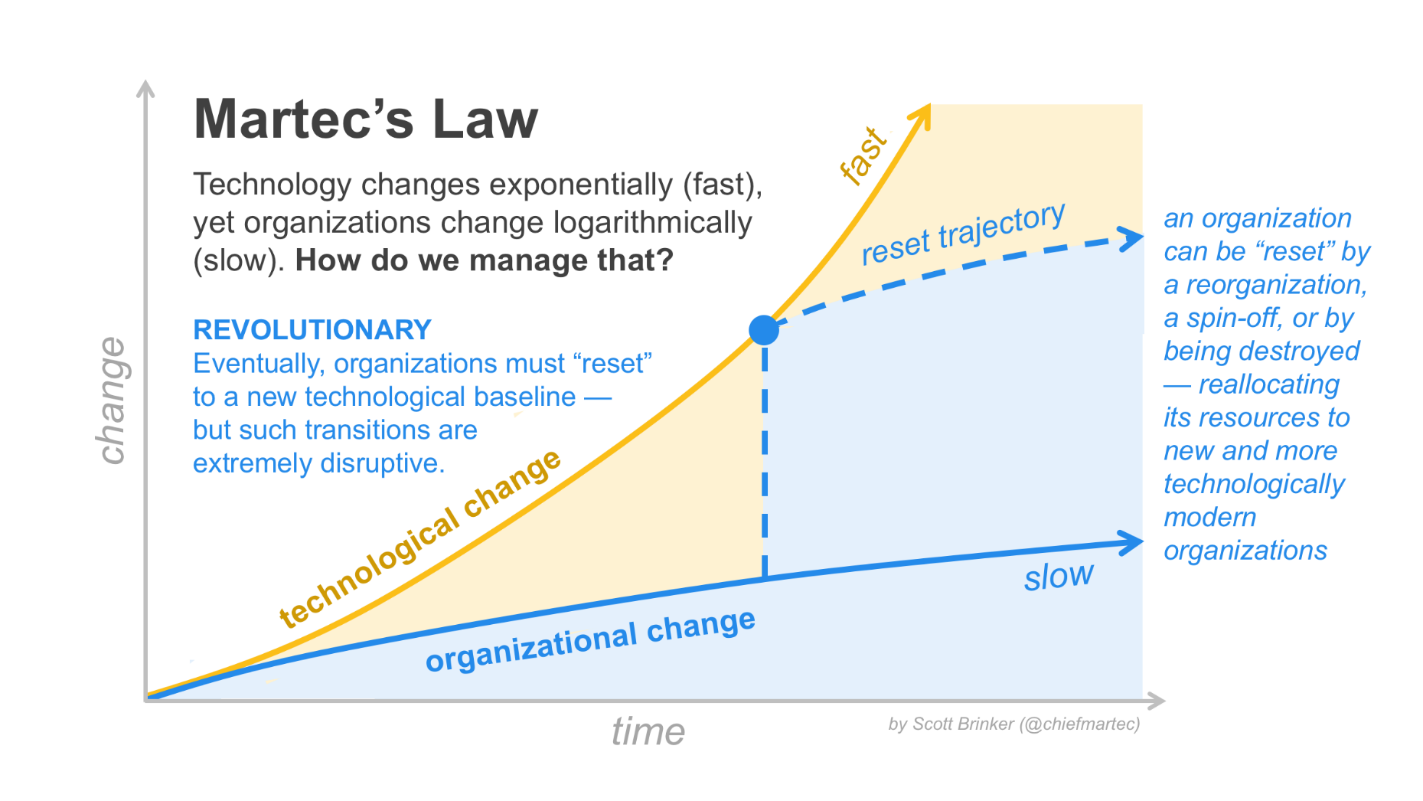
Better Way to Respond: Disrupt

Slide 44
Re-think #1
Dimensions of Quality

Slide 45

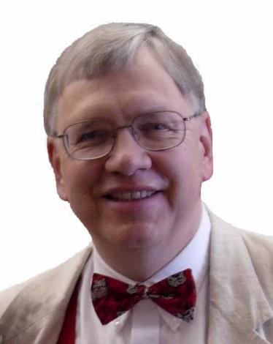

You have taught them;
Have they learnt?
Thomas C. Reeves
Professor Emeritus of Learning Design, and Technology
University of Georgia
2008

Slide 46
Quality from Different Perspectives
Quality of content
  Usually not the issue
  Standard textbooks, derivative material, multimedia courseware
  Library
  Open Educational Resources
Quality of teaching process
  Professional & faculty development
  Teaching evaluation
Quality of the (self-directed) learning process
  Impact on
    Student performance
    Institutional reputation
    Student value-add quality
  Learning design approach
  You have taught them
  have they learnt?

Slide 47
Student Population
Quality of Content
Quality of Teaching
Grades
Quality of Learning
2 σ

Slide 48
#2
Socio-constructivist Connectivist
(Participative & Collaborative)
Learning Pedagogies

Slide 49

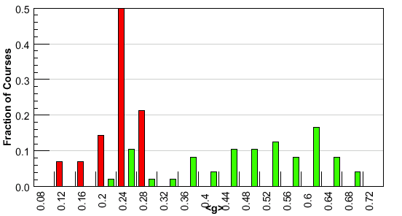
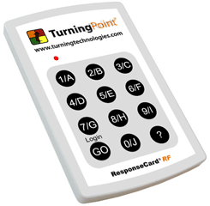
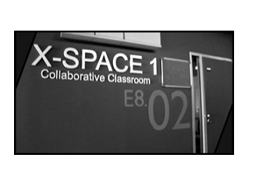

Participative Learning to enhance Learning Quality
Hake, R. R., (1998). Interactive-engagement vs. traditional methods: A six-thousand student survey of mechanics test data for introductory physics courses. American Journal of Physics, 66, 64- 74
Notes:
The y-axis – not important – just signifying the number of samples
web.mit.edu/rsi/www/2005/misc/minipaper/papers/Hake.pdf
The y-axis – not important – just signifying the number of samples
In this article I report a survey of all quantitative pre-/post-test results known to me in time to be included in this report! which use the original Halloun–Hestenes Mechanics Diagnostic test MD the
more recent Force Concept Inventory FCI and the problem-solving Mechanics Baseline MB test. Both the MD and FCI were designed to be tests of students’ conceptual understanding of Newtonian mechanics.
The present survey covers 62 introductory courses enrolling a total of 6542 students using the conceptual MD or FCI exams, and where available! the problem-solving Mechanics Baseline (MB) test.
Can the classroom use of IE methods increase the effectiveness of introductory mechanics courses
well beyond that attained by traditional methods?
For survey classification and analysis purposes I define:
‘‘Interactive Engagement’’: IE methods as those designed at least in part to promote conceptual understanding through interactive engagement of students in heads-on (always) and hands-on (usually) activities which yield immediate feedback through discussion with peers and/or instructors, all as judged by their literature descriptions;
‘‘Traditional’’ (T) courses as those reported by instructors to make little or no use of IE methods, relying primarily on passive-student lectures, recipe labs, and algorithmic-problem exams;
Interactive Engagement IE courses as those reported by instructors to make substantial use of IE methods;

Slide 50
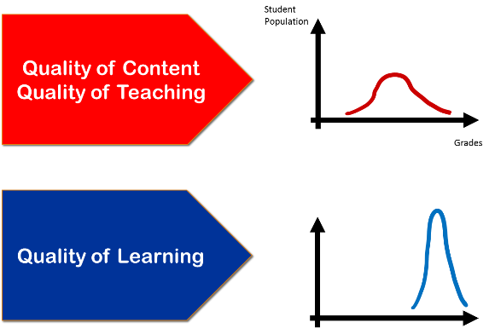
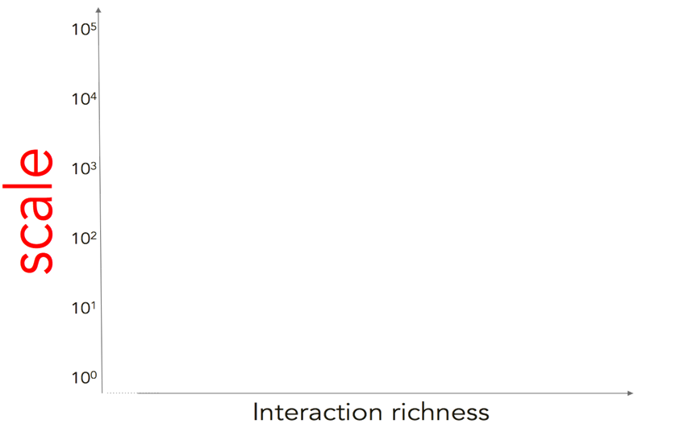
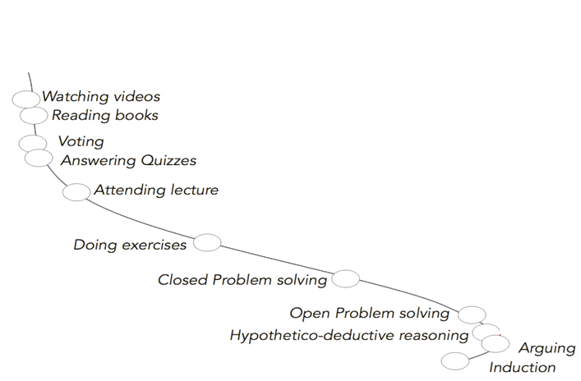
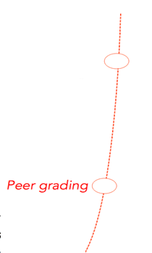
Benefits and Effectiveness of Social Learning
Taylor’s New Pedagogy
Socio-Learner-centric
Transform
Clicker Activities
LAMS
Teacher-centric
Transfer
X-Space
Size of class, audience, group
Source: Pierre Dillenbourg (LASI14, Harvard)
Notes:
Siemen
Activating Latent Knowledge

Slide 51
Answer #1:
What if you do nothing, or a little bit?

Slide 52





Do nothing = doing the same thing
Notes:
Nokia saw themselves as a telephone company, previously timber company
Nokia missed the market change that customers began to measure and use an iphone differently than a traditional cell phone. A smartphone is rather a computer substitute than a conventional phone.
While Nokia still concentrates on their hardware development, Apple and Google develop new operating systems and create software ecosystems of softwarer (apps) around their products.
Customers start buying more and more smartphones and ignore traditional cell phones.
In the smartphone category Nokia is not able to offer competitive products.
Kodak – chemical company
borders

Slide 53


Randy Garrison
George Siemens
Dominique Abrioux
Terry Anderson
Jon Baggaley
“critical part of the infrastructure for distance education in Canada, providing courses and programs, research and leadership in this field”
Source: https://www.tonybates.ca/2018/05/18/athabasca-universitys-centre-for-distance-education-to-close/

Slide 54

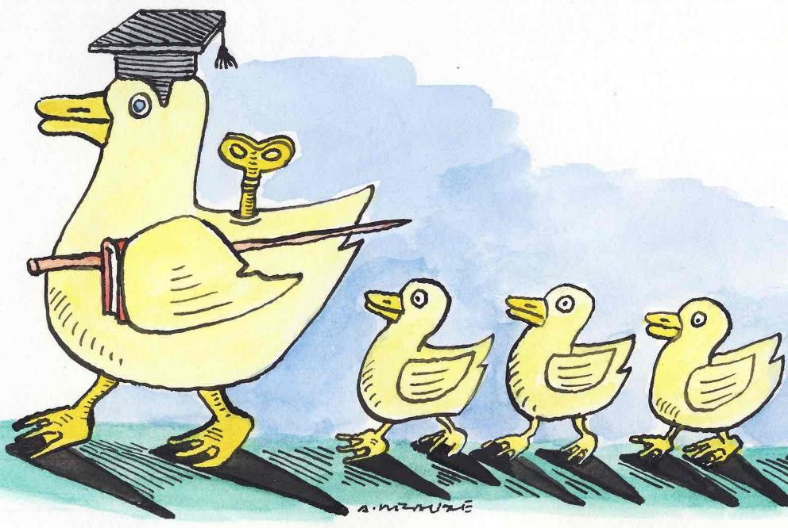
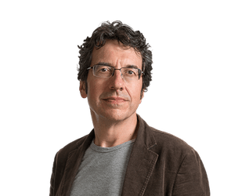
In an age of robots, schools are teaching our children to be redundant
In the future, if you want a job, you must be as unlike a machine as possible: creative, critical and socially skilled (team).
You exist, but your students die
Stone Age ended not because they ran out of stones
Wednesday 15 February 2017 07.00 GMT
George Monbiot
Source: https://www.theguardian.com/commentisfree/2017/feb/15/robots-schools-teaching-children-redundant-testing-learn-future
Notes:
You exist, but your students die

Slide 55

Author: Jenna Filipkowski, PhD (Jenna.Filipkowski@HCI.org)
Publication date: June 30, 2015 v.2
Collaboration U: Business and University Partnerships To Secure Talent Pipelines
  Employers are struggling to find college graduates with the necessary skills for their jobs
Employers are encountering a "significant and constantly growing skills gap in today's workforce" and "there appears to be a disconnect between higher education institutions that are preparing the next generation of workers and the employers who expect to hire them."
Source: Human Capital Institute (2015), Collaboration U: Business and University Partnerships To Secure Talent Pipelines. http://www.hci.org/hr-research/collaboration-u-business-and-university-partnerships-secure-talent-pipelines

Slide 56
Answer #2
Do something great

Slide 57



Do something great #1

Slide 58

Do something great #2
Campus wide lecture recording
Clickers for social learning
Learning Spaces for socio-constructivist learning
LAMS for online social learning and learning engagement

Slide 59

Gen Y & Z Students
Tech savvy
  Continually connected on smart mobile devices
  Socially connected
Cosmopolitan
  Influenced by peers
  Social concerns
  More universally homogenous
Short attention span
  Skim text and information quickly
  Demand personal attention
Achievement oriented
  Seek recognition, fame and feedback
  Wants meaningful work and a solid learning curve
  Stronger entrepreneural spirit
Team-Oriented
  Value teamwork and seek the input and affirmation of others
  Loyal, committed and wants to be included and involved
  Connected closer to friends than families

Slide 60
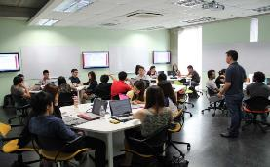
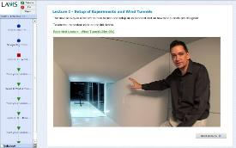
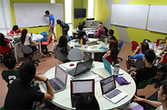
Learning Quality via Social Learning
Learning is Everywhere with Everyone
Participative
Collaborative
Sustainable
Professor-friendly

Slide 61
R#3:
Learning Spaces to create
Socio-constructivist Connectivist
Culture

Slide 62
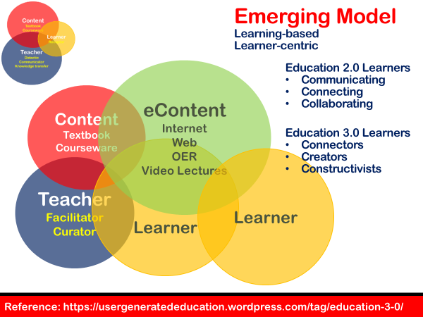
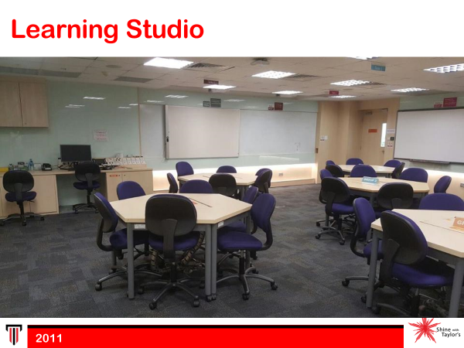
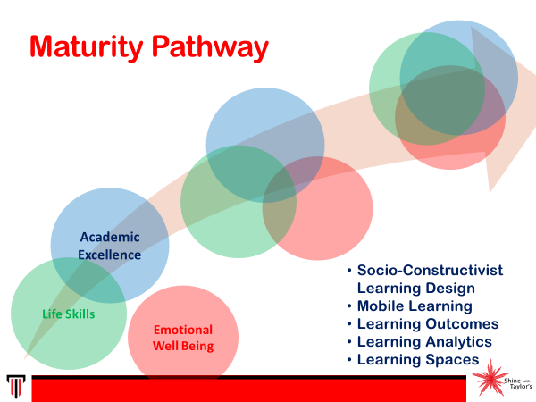
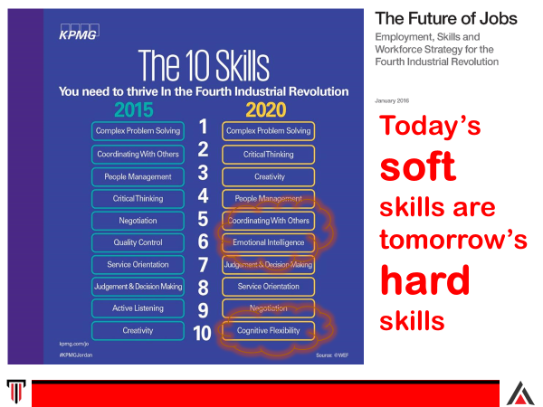
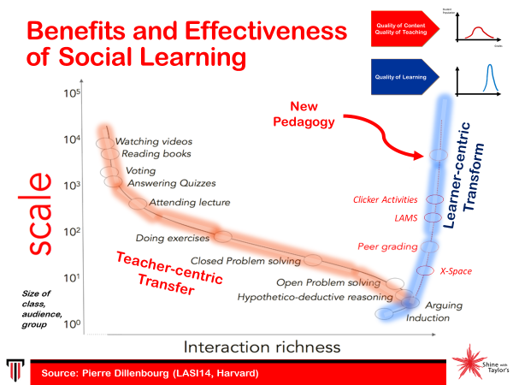


Learning Space

Slide 63



Philosophy of Next Gen Learning Spaces
Campus wide pedagogical culture
Noisy Classroom
Wandering Professor
Professor-friendly design
+ Faculty development & training
Faculty Recognition: Student Teaching Feedback redesign
Co-opetition: co-operation and competition
2011
2012
2015
Notes:
Fiona Reynolds – use of fractals

Slide 64

Traditional Classroom Design
1986 - Pre-2011

Slide 65



TR+: Professor-friendly Learning Space @ NTU

Slide 66


Slide 68









Taylor’s Education Group

Slide 69

Learning Spaces at Taylor’s University:
X-Space Collaborative Classroom

Slide 70



Learning Spaces at
http://www.nexus.edu.my/

Slide 71


Slide 72


Slide 73


Slide 74
Do something great #3
Holistic education approach

Slide 75
Current situation today
Academic Excellence
Life Skills
Emotional Well Being

Slide 76

Taylor’s Holistic Education Response
K12 to Higher Ed
Academic Excellence
Life Skills
Emotional Well Being

Slide 77
Maturity Pathway
Academic Excellence
Life Skills
Socio-Constructivist Learning Design
Mobile Learning
Learning Outcomes
Learning Analytics
Learning Spaces
Emotional Well Being

Slide 78
Responsive to Context
Generic
Service Industry
Research

Slide 79
Meta-Learning:
Learn, reLearn, unLearn
Learning how to learn: reflection, expertise, curiosity, creativity, contextualization, self-critique
Passion
Growth mindset
Academic Excellence
Life Skills
Emotional Well Being
Notes:
• Meta-Layer: essential for activating transference, building expertise, fostering creativity via analogies,
establishing lifelong learning habits, and so on. It will answer questions such as: How should students
learn how to learn? What is the role of interdisciplinarity? What is the appropriate sequencing within
subjects and between subjects? How do we develop curiosity? How do we facilitate students’ pursuing
of their own passions in addition to the standard curriculum? How do we adapt curricula to local
needs? etc.

Slide 80
What kind of the university do you want?
Good universities
teach
Great universities
transform

Slide 81

Dr Daniel Tan
ethtan@outlook.com

